Slide 1
Theory of Automata
Lecture # 09
Dr. Muhammad Fayaz

Slide 2
Revision
Definition of Languages
Descriptive Definition of Languages
Regular Expression
Finite Automata
Non-Deterministic Finite Automata (NFA)
Deterministic Finite Automata (DFA)
Conversation of NFA to DFA
Union of Two FAs
Concatenation of Two FAs
Intersection of Two FAs

Slide 3
Intersection of Two FAs

Slide 4
Method 1 (Demorgan's law)

Slide 5
Complement of a language
Let L be a language defined over an alphabet Σ, then the language of strings, defined over Σ, not belonging to L, is called Complement of the language L, denoted by L^{c} or L/.
Note: To describe the complement of a language, it is very important to describe the alphabet of that language over which the language is defined.
For a certain language L, the complement of L^{c} is the given language L i.e. (L^{c})^{c} = L
Theorem: If L is a regular language, then, L^{c} is also a regular language.

Slide 6
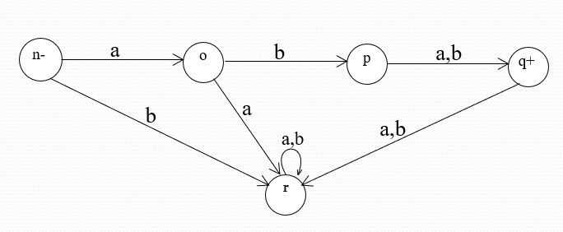
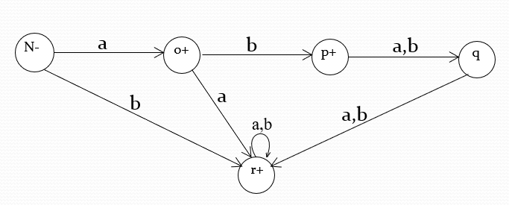
Example
Let L be the language over the alphabet Σ = {a, b}, consisting of only two words aba and abb, then the FA accepting L may be
Converting final states to non-final states and old non-final states to final states, then FA accepting L^{c} may be
Original DFA
Complemented DFA

Slide 7
Example
((a+ b) (a + b))* - For Even Length Strings
a, b
x ±
y
a, b
((a+ b) (a + b))* - For Odd Length Strings
a,b
–
+
a,b

Slide 8
Theorem
Statement: If L₁ and L₂ are two regular languages, then L₁ Ո L₂ is also regular.
Proof: Using De-Morgan's law for sets
(L₁^{c} U L₂^{c})^{c} = (L₁^{c})^{c} Ո(L₂^{c})^{c} = L₁ Ո L₂
Since L₁ and L₂ are regular languages, so are L₁^{c} and L₂^{c}.
L₁^{c} and L₂^{c} being regular provide that L₁^{c} U L₂^{c} is also regular language and so (L₁^{c} U L₂^{c})^{c} = L₁ Ո L₂, being complement of regular language is regular language.
(FA₁^{c} U FA₁^{c})^{c} = (FA₁^{c})^{c} Ո(FA₂^{c})^{c} =FA₁ Ո FA₂

Slide 9
Remark
Following is a remark
If L₁ and L₂ are regular languages, then these can be expressed by the corresponding FAs.
Finding regular expressions defining the language
L₁ Ո L₂ is not so easy and building corresponding FA is rather harder.
Following is an example of finding an FA accepting the intersection of two regular languages

Slide 10
Example
Consider two regular languages L₁ and L₂, defined over the alphabet Σ = {a, b}, where
L₁ = language of words with double a’s.
L₂ = language of words containing even number of a’s.
FAs accepting languages L₁ and L₂ may be as follows

Slide 11
Example
(FA₁^{c} U FA₁^{c})^{c} = (FA₁^{c})^{c} Ո(FA₂^{c})^{c} =FA₁ Ո FA₂
Let r₁= (a+b)*aa(a+b)* defines L₁ and FA₁ be
and r₂= b+ (b*ab*ab*)* defines L₂ and FA₂ be
b
a,b
b
a,b
a
a
Complemented
P+
q+
a
q
a
r+
-
r
p-
b
b
FA₁^{c}
b
b
b
a
b
a
Complemented
-
1-
2+
1
2
+
a
a
FA₂^{c}
1.The initial state of FA3 must correspond to the initial state of FA1 and the initial state of FA2.
2. The final state of FA₃ must correspond to a final state of FA₁ or FA₂ or both.
Now: L₁^{c} U L₂^{c}

Slide 12
Example
Old States | New States after reading
 | a | b
z₁ ±=(p,1) | (q,2)=z₂ | (p,1)=z₁
z₂+=(q,2) | (r,1)=z₃ | (p,2)= z₄
z₃=(r,1) | (r,2)=z₅ | (r,1)= z₃
z₄+=(p,2) | (q,1)= z₆ | (p,2)= z₄
Z₅+=(r,2) | (r,1)= z₃ | (r,2)= z₅
z₆+=(q,1) | (r,2)= z₅ | (P,1)= z₁
FA₁^{c}
FA₂^{c}
U
b
a, b
a
P+
q+
a
-
r
b
FA₁^{c}
Z₁±
b
b
b
a
b
a
b
1-
2+
z₄+
z₂+
z₆+
b
a
a
a
FA₂^{c}
b
a
b
a
1.The initial state of FA3 must correspond to the initial state of FA1 and the initial state of FA2.
2. The final state of FA₃ must correspond to a final state of FA₁ or FA₂ or both.
z₃
z₅+
a

Slide 13
Example continued …
(L₁^{c} U L₂^{c})^{c} = (L₁^{c})^{c} Ո(L₂^{c})^{c} = L₁ Ո L₂
An FA that accepts the language (L₁^{c} U L₂^{c})^{c} = L₁Ո L₂ may be Corresponding RE can be determined as follows
Z₁-
b
a
b
b
z₂
z₄
z₆
b
a
a
a
b
a
b
Z₃+
z₅
a
FA3=
(FA₁^{c} U FA₁^{c})^{c} =FA₁ Ո FA₂

Slide 14
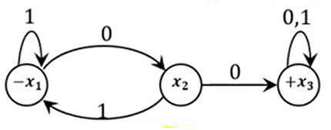
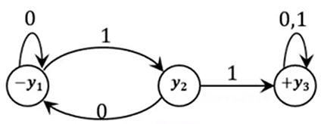
Practice
FA₁
FA₂

Slide 15
Intersection of Two FAs
Method 2 (Short Method)

Slide 16
Example
Old States | New States after reading
 | a | b
z₁ -=(p,1) | (q,2)=z₂ | (p,1)=z₁
z₂ =(q,2) | (r,1)=z₃ | (p,2)= z₄
Z₃+=(r,1) | (r,2)=z₅ | (r,1)= z₃
z₄=(p,2) | (q,1)= z₆ | (p,2)= z₄
Z₅ =(r,2) | (r,1)= z₃ | (r,2)= z₅
z₆ =(q,1) | (r,2)= z₅ | (P,1)= z₁
FA₁ Ո FA₂
b
a,b
a
p-
q
a
r+
b
Z₁-
FA₁
b
b
b
a
b
a
b
-
1
2
z₂
z₄
z₆
+
b
a
a
FA₂
a
a
b
a
b
1.The initial state of FA3 must correspond to the initial state of FA1 and the initial state of FA2.
2. The final state of FA₃ must correspond to the final states of FA₁ and FA₂ .
Z₃+
z₅
a

Slide 17
Practice
FA₁
FA₂

Slide 18
Rules
Union of two FAs
1.The initial state of FA3 must correspond to the initial state of FA1 and the initial state of FA2.
2. The final state of FA₃ must correspond to a final state of FA₁ or FA₂ or both.
Concatenation two FAs
1. The initial state of FA3 must correspond to the initial state of FA1
2. The final state of FA3 must correspond to the final state of FA2.
3. The moment a final state of first FA1 is entered, the initial state of second FA2 will be included as well
Intersection of two FAs (Short Method)
1.The initial state of FA3 must correspond to the initial state of FA1 and the initial state of FA2.
2. The final state of FA3 must correspond to the final states of FA1 and FA2 .

Slide 19
Context Free Grammar

Slide 20
Definition of Context Free Grammar
CFG is the collection of the followings
An alphabet Σ of letters called terminals from which we are going to make strings that will be the words of a language.
A set of symbols called non-terminals, one of which is S, stands for “start here”.
A finite set of productions

Slide 21
Why Context Free Grammar?
The context free grammar has the capability to generate the words of any type of language as compared to the regular expression
The context free can generate a palindrome language
(( reverse (words) = words ))
The context free grammar can generate languages of the form:
“Number of a’s must be equal to number of b’s”
“Number of a’s must be double of number of b’s” ,etc.

Slide 22
CFG terminologies
Terminals: The symbols that can’t be replaced by anything are called terminals.
Note: The terminals are designated by small letters
Non-Terminals: The symbols that must be replaced by other things are called non-terminals.
Note: The non-terminals are designated by capital letters
Productions: The grammatical rules are often called productions rule. Productions can be written in the form:
α → β
The symbol “→” means “can be replaced by”
= aa
S aS
The symbol “ ” means “can develop into”
The symbol “ = ” means
“ string is generated ”

Slide 23
CFG terminologies
α → β
Single Non-terminal
[A or B or C……. Z]
Empty String
˄
Mixture of no-terminals
[AAB, BCA, CC... Etc.]
Mixture of terminals and not-terminals
[ABbc , Abbd, etc.]
Single terminal
[a or b or c……. d]
Mixture of terminals
[aabc , bbbd, etc.]

Slide 24
Context Free Language (CFL)
The language generated by CFG is called Context Free Language (CFL).
Example 1:
R.E = a* = {˄, a, aa, aaa, aaaa…}
CFG Prod:
S →aS
S→˄
aaa can be generated by applying prod. (1) thrice the prod. (2) and so on
S aS
aaS
aaaS
aa can be generated by applying prod. (1) twice and then prod. (2)
S aS
aaa˄
= aaa
aaS
aa ˄
= aa
a can be generated by applying prod. (1) once and prod. (2)
S aS
a˄
= a
Applying prod. (2), ˄ can be generated
S ˄

Slide 25
Regular Expression to CFG Conversion
S bS
baS
Example 2:
R.E = (a+b) * = {˄, a, b, aa , bb, ab, ba, aaa, bbbb …}
CFG Prod:
S →aS
S→bs
S →
ba ˄
= ba
ba can be generated by applying prod. (2) and prod. (1) once, and then prod. (3)
˄
ab can be generated by applying prods. (1) and prod. (2) once and then prod. (3).
Applying prod. (2), ˄ can be generated
S aS
abS
ab ˄
= ab
S ˄
a can be generated by applying prod. (1) once then prod. (3)
b can be generated by applying prod. (2) once then prod. (3)
aa can be generated by applying prod. (1) twice then prod. (3)
bb can be generated by applying prod. (2) twice and then prod. (3)
S aS
S bS
S aS
S bS
a˄
= a
b˄
= b
aaS
bbS
aa ˄
= aa
bb ˄
= bb

Slide 26
Thanks

